Slide 1

Back to the basics: Adapter & State.
Explaining design patterns with real life examples

Slide 2

About me
I am a software engineer with more than 8 years of experience. I joined Endava near the end of 2024.
Most of my experience comes from a previous telemedicine project, where I’ve worked as a backend developer for its various applications (SQL Server Database, .NET Web Api, WPF, MVC) developing new features, integrating new medical devices, and also adjusting the Angular frontend when needed. I’ve also done some junior/intern mentoring in the later years.
Outside of work I’m passionate about programming, video games, and piano.
Daniel-Laurentiu.Schmidt@endava.com
Senior Developer
Daniel Schmidt

Slide 3

Target audience
Developers
Technical leads

Slide 4
Introduction
What are design patterns?
In software engineering, a design pattern is a repeatable solution to a commonly occurring problem in software design.
The pattern is not a specific piece of code, but a general concept for solving a particular problem (that can be used in many different situations).

Slide 5
Introduction
Categories of design patterns
Creational patterns: provide object creation mechanisms that increase flexibility and reuse of existing code.
Structural patterns: explain how to assemble classes into structures, while keeping these structures flexible.
Behavioral patterns: provide solution for the better interaction between objects, lose coupling, and flexibility to extend easily

Slide 6

Introduction
Creational patterns
Singleton – Ensures a class has only one instance and provides a global point of access to it.
Factory Method – Uses factory methods to deal with the problem of creating objects without having to specify their exact classes.
Abstract Factory – Provides an interface for creating families of related or dependent objects without specifying their concrete classes.
Builder – Separates the construction of a complex object from its representation.
Prototype – Creates new objects by copying an existing object (a prototype)

Slide 7

Introduction
Structural patterns
Adapter – Allows incompatible interfaces to work together.
Bridge – Separates an object’s abstraction from its implementation so the two can vary independently.
Composite – Composes objects into tree structures to represent part-whole hierarchies.
Decorator – Adds responsibilities to objects dynamically without changing their code.
Facade – Provides a unified interface to a set of interfaces in a subsystem.
Flyweight – Reduces memory usage by sharing common parts of objects instead of creating duplicates.
Proxy – Provides a substitute or placeholder to control access to another object

Slide 8
Introduction
Behavioral patterns
Chain of Responsibility – Passes a request along a chain of handlers until one handles it.
Command –Encapsulates a request as an object, allowing for parameterization and queuing.
Interpreter – Defines a grammar for a language and provides an interpreter to process it.
Iterator –Provides a way to access elements of a collection without exposing its structure.
Mediator – Centralizes communication between objects to reduce direct dependencies.
Memento – Captures and restores an object’s internal state without violating encapsulation.
Observer –Allows objects to be notified when another object changes state.
State –Allows an object to alter its behavior when its internal state changes.
Strategy – Defines a family of algorithms and makes them interchangeable.
Template Method – Defines the skeleton of an algorithm, deferring some steps to subclasses.
Visitor –Separates an algorithm from the objects it operates on

Slide 9
Adapter
Definition
Adapter is a structural design pattern that allows incompatible interfaces to collaborate.
Pros
Separation of Concerns - The adapting code is extracted in a separate class (the adapter).
Open/Closed Principle (OCP) – You can add multiple adapters sharing the same interface but adapting different systems.
Single Responsibility Principle (SRP) – The adapter has only one reason to change. If the system it adapts changes.

Slide 10
Adapter
Real life application context:
A medical booth for remote consultations equipped with medical devices for performing various
measurements (blood pressure, oximetry, weight).
An admin dashboard used to define cabin and doctor schedules.
A patient application allowing patients to make appointments for cabins and doctors.
An integration with a third party doctor database and schedule/appointment management application.
The requirements were for our schedules and appointments to be synchronized into the third party system, so the doctors could see them there.

Slide 11
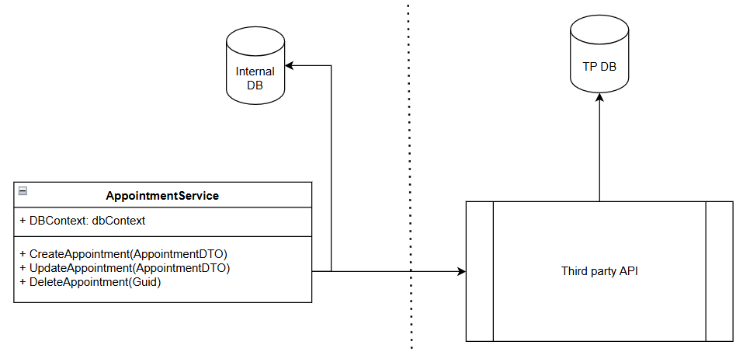
Adapter
The problems
The naïve solution would be to just write the code for this integration inline, where needed. The problem with this approach is that the code loses focus, as the processing required for integration could get quite big. Then, assuming you need the same code in multiple places, you’d have code duplication.
A step in the right direction is extracting the code into methods.
But go one step further and you arrive at the Adapter design pattern

Slide 12
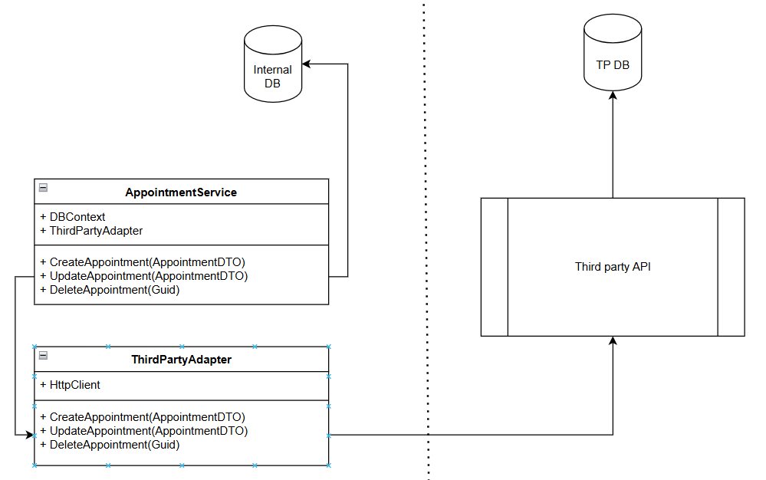
Adapter
The solution
Create a dedicated class that encapsulates the integration logic between the two systems.

Slide 13
Adapter
Implementation
https://github.com/Iamsdl/Endava-DesignPatterns/tree/main/Adapter

Slide 14
State
Definition
State is a behavioral design pattern that lets an object alter its behavior when its internal state changes. It’s the proper way to model a Finite-state machine - Wikipedia in code.
Pros
Single Responsibility and Encapsulation – Behaviors are contained in State classes. The only reason for a state class to change is if the state machine changes.
Open-Closed Principle – New states can be added to the machine with minimal effort.
Liskov Substitution Principle (LSP) – The whole pattern revolves around it. States are interchangeable.

Slide 15
State
Real life application context:
A “Blender” style VR 3D modelling application featuring:
An “Object Mode”, allowing the user to manipulate (move, rotate, scale) of objects in the scene
An “Edit Mode” allowing the user to edit (add vertices, faces, extrude) a single object
A “Particle mode” allowing the user to play around with particles
Being in VR, the application had to use a small number of gestures to implement a larger number of functionalities.

Slide 16
State
The problems
Having few inputs but many outputs means the code has many branching paths
Writing these paths with plain enums, ifs and switches becomes hard to read and maintain
Both changing and extending the behavior is difficult and means going back to the if/switch conditions

Slide 17
State
The solution
Move each branching path in a “state” class.

Slide 18
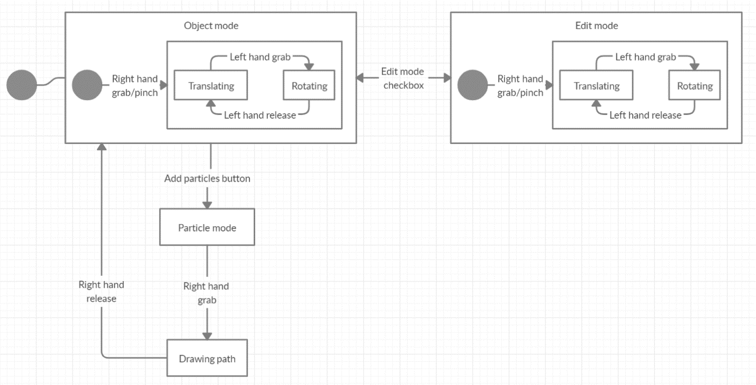
State
Real life application context:

Slide 19
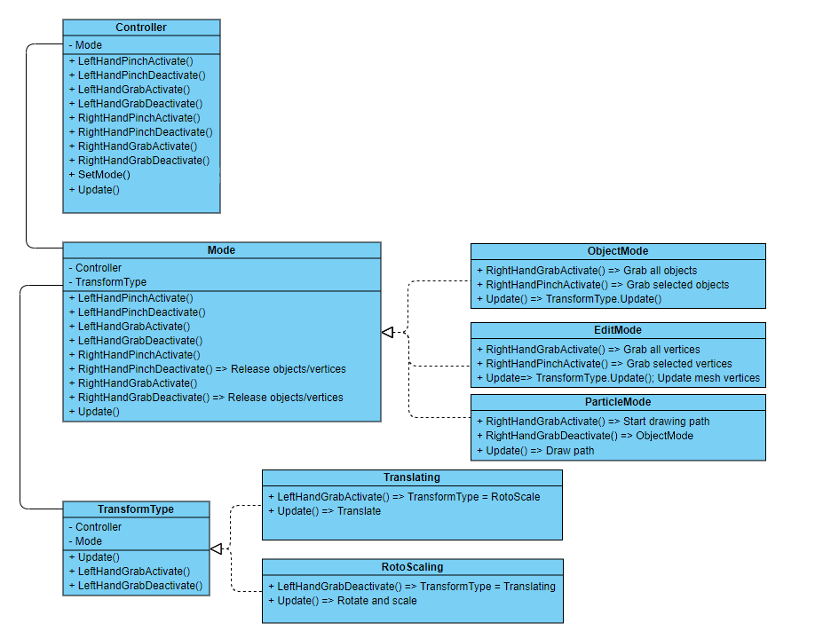
State
Real life application context:

Slide 20
State
Implementation
https://github.com/Iamsdl/GMRV-Modelator3DCuGesturi/tree/master/Assets/Scripts

Slide 21
Bibliography
https://refactoring.guru/design-patterns/adapter
https://refactoring.guru/design-patterns/state

Slide 22
Q & A

Slide 23
Thank you

